Slide 1
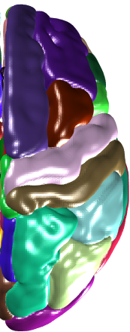
(How undergraduate researchers can contribute to) Computer Vision for Brain Imaging Analysis
Seong Jae Hwang
Computer Science
sjh95@pitt.edu
Oct. 16, 2020

Slide 2
Overview
Brief list of questions in CV/ML and Medical Imaging answered by CV/ML methods
Current Projects
Computer vision problem
Domain Generalization
Undergraduate researcher contribution
Medical imaging problem
Led by an undergraduate researcher

Slide 3
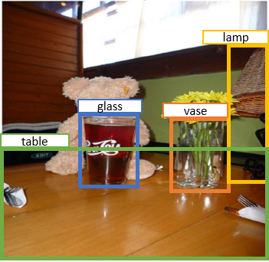
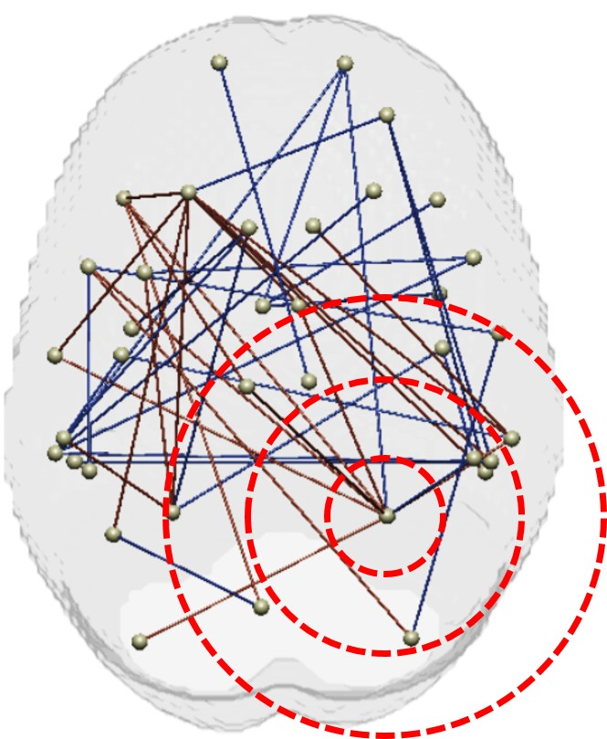
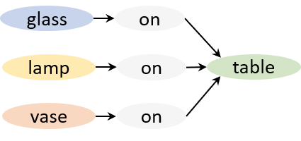
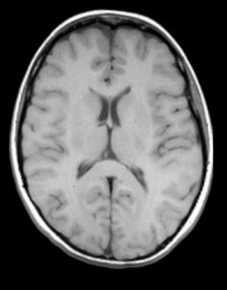
Can we detect how brain networks differ between healthy and diseased?
Can we detect how objects are visually related in image?
Can we automatically segment diseased region in a brain?
Can we model and understand how neurodegenerative diseases develop over time?
Can we identify “good” clinical study participants (i.e., who will provide most information about the drug effect)?
BIOMARKER
AGE
Notes:
There are other problems that look for the relationship between the images on the internet
Subjects in a clinical trial,
and brain images of healthy and diseased groups

Slide 4
Problem Setup
Typical machine learning: Train on training set and test on test set.
Assumption: Training set, Test set $\sim ℙ$ (i.e., from the same distribution $ℙ$)
$$ℙ$$

Slide 5
Problem Setup
Typical machine learning: Train on training set and test on test set.
Assumption: Training set, Test set $\sim ℙ$ (i.e., from the same distribution $ℙ$)
New assumption: Training set $\sim ℙ$, Test set $\sim ℚ$ (i.e., from different distributions)
Question: Can a model trained on Training set $\sim ℙ$ perform well on Test set $\sim ℚ$?
i.e., Train on images of Photo, Art, and Sketch (Sources), and test on images of Cartoon (Target)
Source
Target
$$ℙ$$
$$ℚ$$

Slide 6
Domain Adaptation and Generalization
Domain Adaptation (DA): If you have some knowledge about Target $\sim ℚ$
Samples from Target $\sim ℚ$ (often without labels)

Slide 7
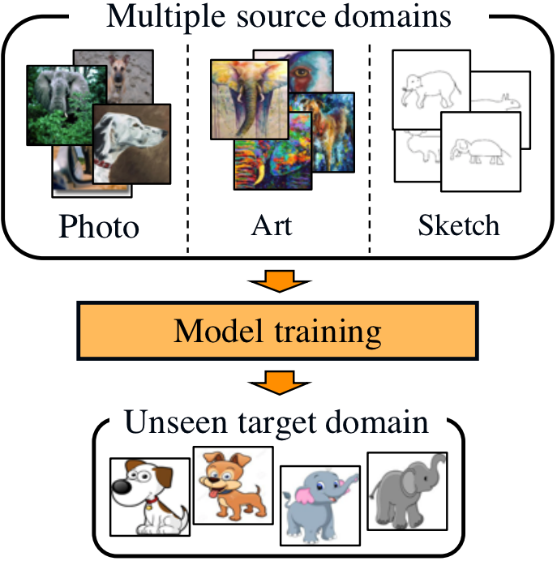
Domain Adaptation and Generalization
Domain Adaptation (DA): If you have some knowledge about Target $\sim ℚ$
Samples from Target $\sim ℚ$ (often without labels)
Domain Generalization (DG): If you have no knowledge about Target $\sim ℚ$
Extremely difficult: no samples, no labels, no hints about Target $\sim ℚ$
(Multiple) Source Domains $ℙ_{1},ℙ_{2},ℙ_{3}$
Target Domain $ℚ$
Matsuura and Harada 2020

Slide 8
Domain Adversarial Neural Networks (DANN)
DANN: learns features that cannot tell which domain a sample $x$ is from
For DA: Cannot tell if $x$is from Source Domains $ℙ_{i}$ or Target Domain $ℚ$

Slide 9
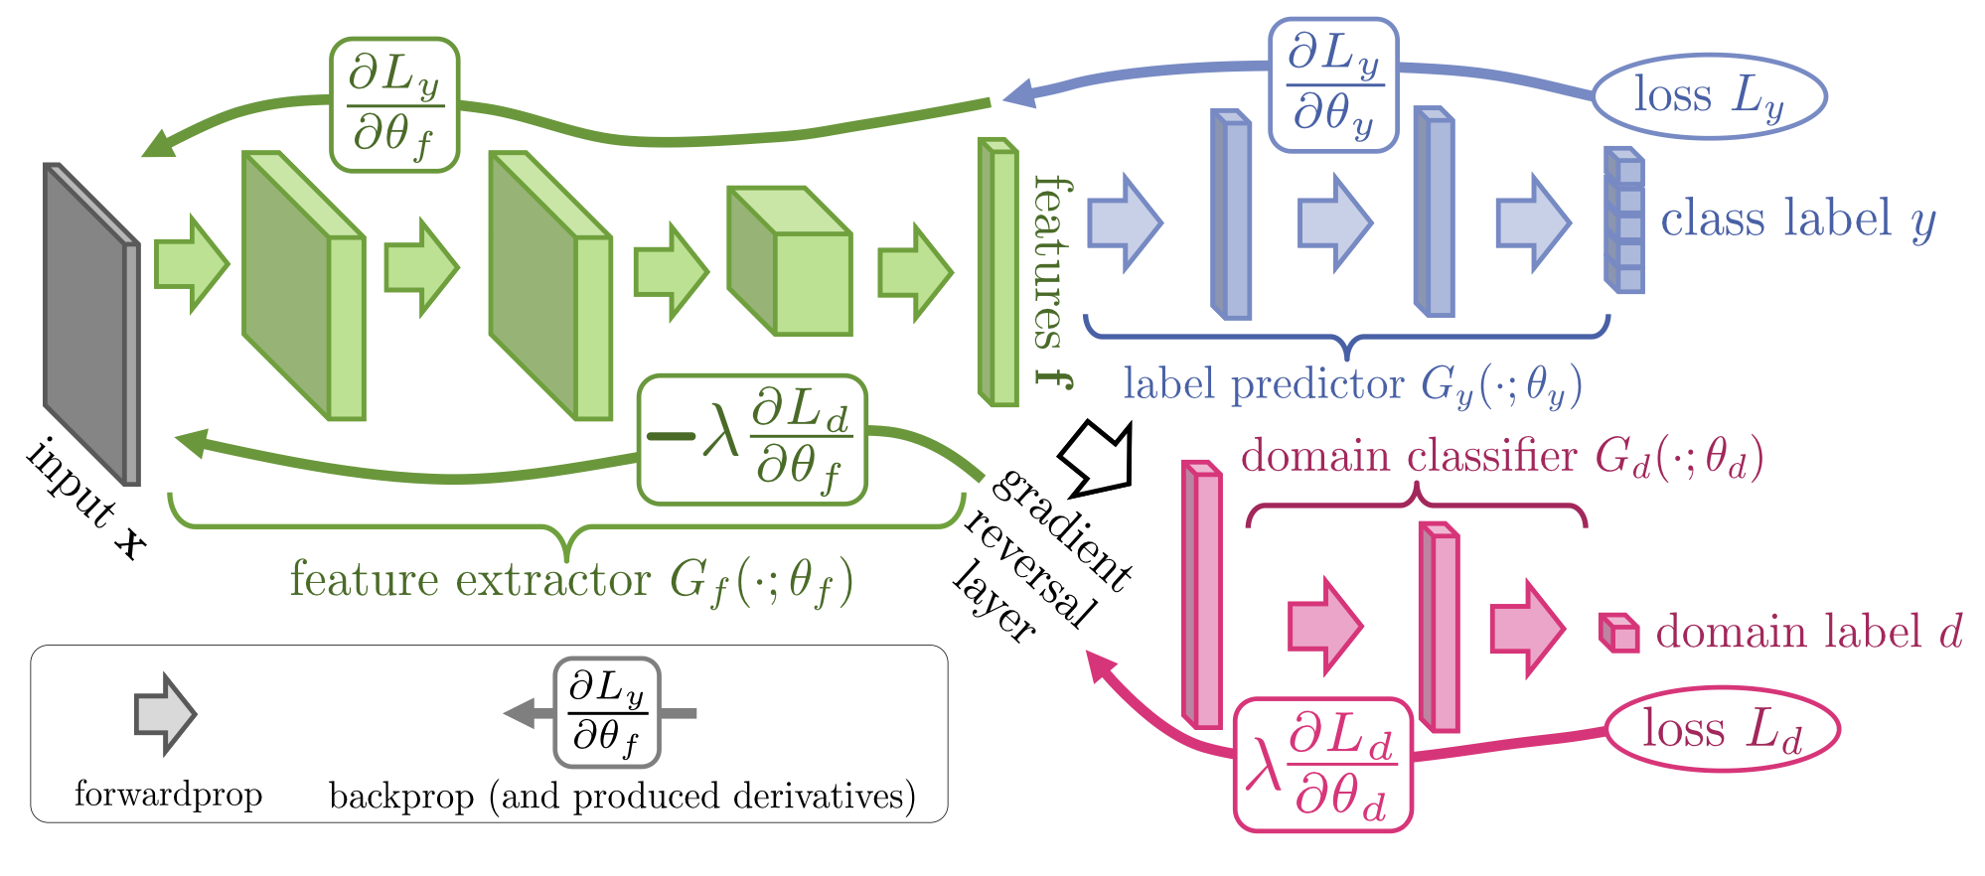
Domain Adversarial Neural Networks (DANN)
DANN: learns features that cannot tell which domain a sample $x$ is from
For DA: Cannot tell if $x$is from Source Domains $ℙ_{i}$ or Target Domain $ℚ$
How: Model can derive features that (1) improves class classification while (2) “fooling” domain classifier
Classify objects (dogs, humans, etc.) based on class information while explicitly hiding domain information (image style, etc.)
Ganin and Lempitsky 2015

Slide 10
Our Recent Work
For DG: Cannot tell if $x$is from a specific Source Domains $ℙ_{i}$
Issue: But DANN was not originally developed for DG! How do you know if DANN works for Target Domain $ℚ$?
Goal: Theoretically identify when DANN works for DG and find an algorithmic approach to improve it.

Slide 11
Our Recent Work
For DG: Cannot tell if $x$is from a specific Source Domains $ℙ_{i}$
Issue: But DANN was not originally developed for DG! How do you know if DANN works for Target Domain $ℚ$?
Goal: Theoretically identify when DANN works for DG and find an algorithmic approach to improve it.
Thanks to our undergraduate researcher: Xingchen Zhao
Since February
2 submissions as 2nd author
SCI Undergraduate Research Scholars Award this summer
Has been extremely valuable to our group

Slide 12
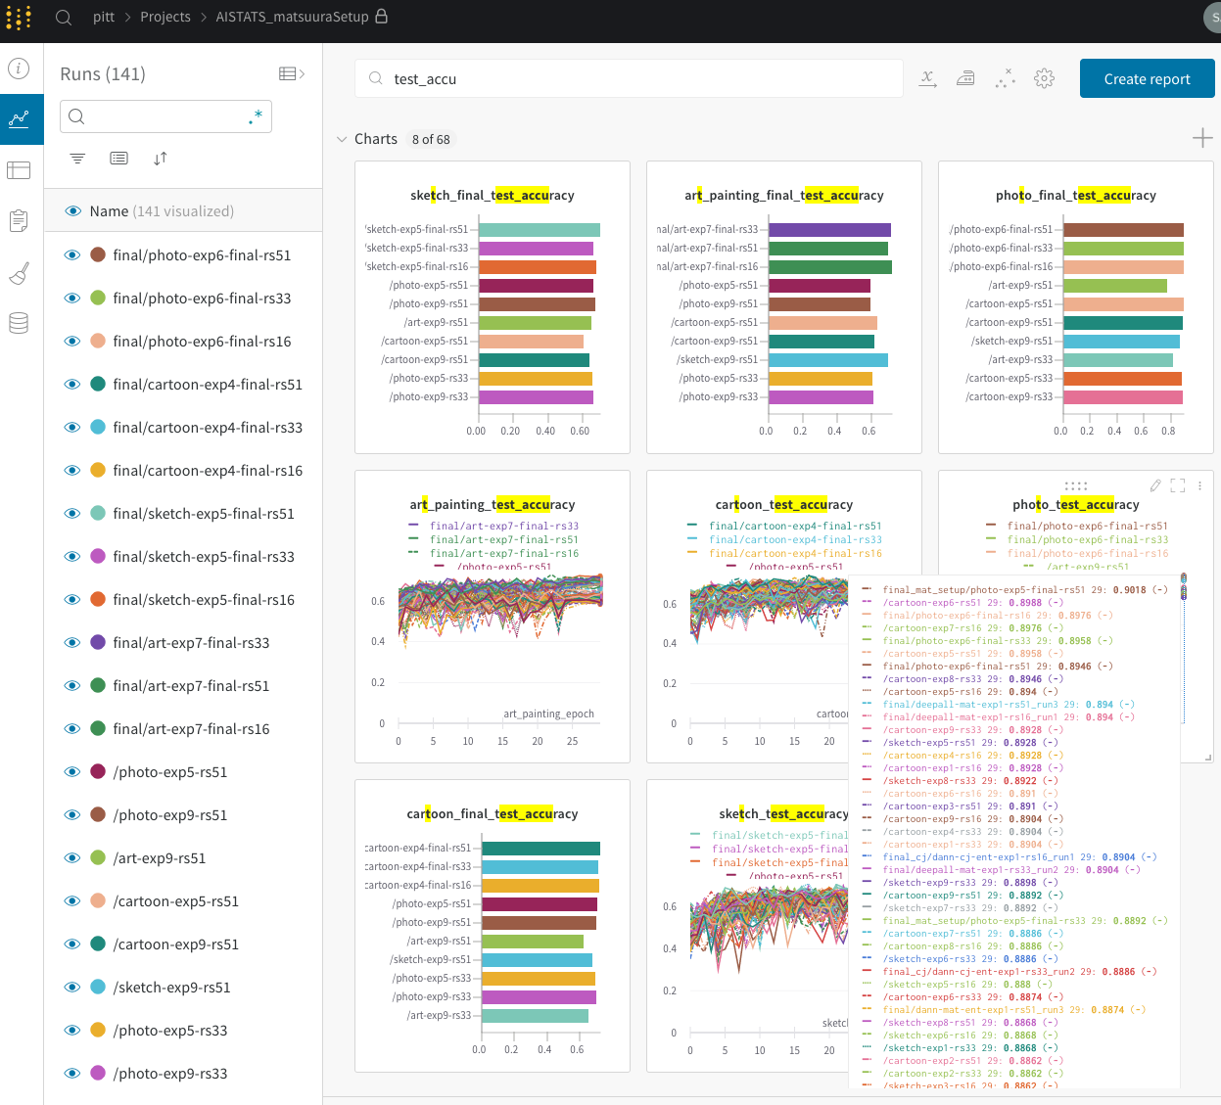
What has Xingchen been up to?
~120 days of GPU compute
~4000 experiments
Pytorch (Deep learning framework)
W&B (Machine learning experiment framework)
All remotely

Slide 13
Growing as an Undergraduate Researcher
So far,
Conduct experiments
Organize and interpret results
Search for recent papers
Propose and implement ideas
This is basically the entire research…almost!
Writing a paper is a different story. But…
He is leading a project for a first author paper submission.

Slide 14
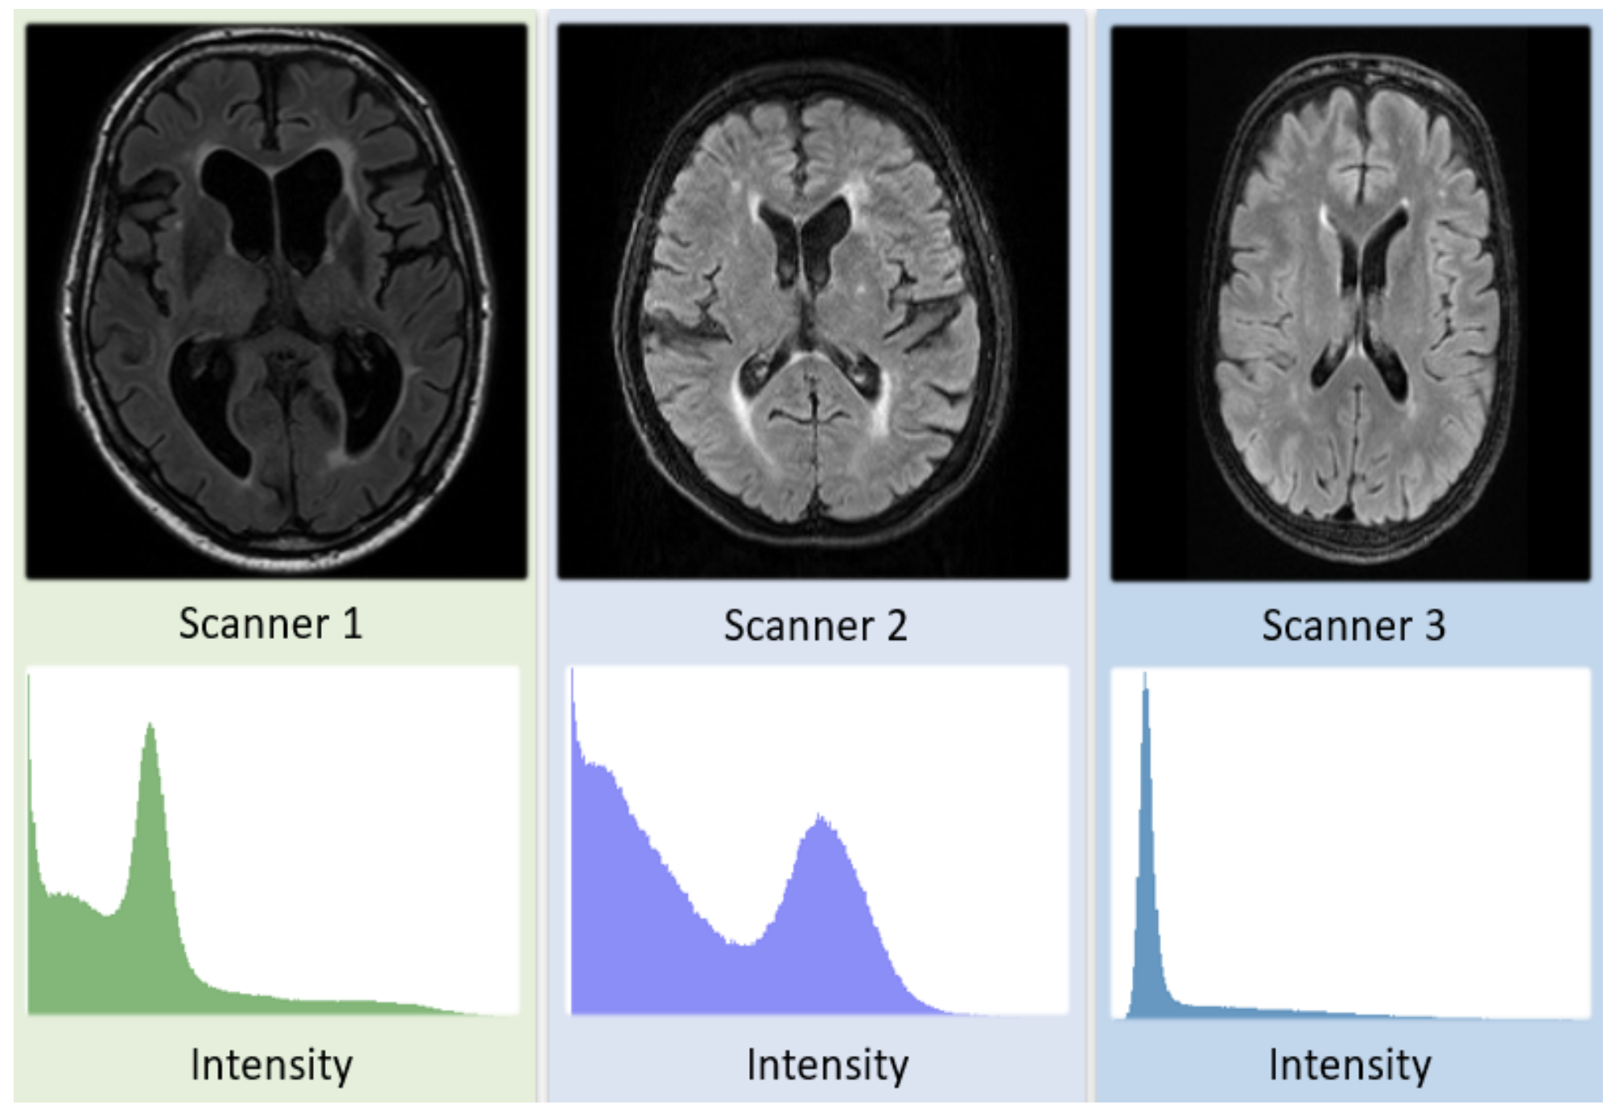
DG in Medical Imaging Analysis
DG is becoming a prevalent problem in medical imaging analysis
Growing datasets from multiple different domains:
sites, scanners, populations construct different “distributions”
How can we ensure a model learned using Pitt MRIs (source) also work well on other MRIs from new, unseen schools (target)?
Li et al., 2020

Slide 15
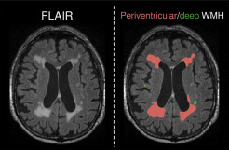
DG in Medical Imaging Analysis
Goal: Develop a white matter hyperintensity (WMH) segmentation method for multi-site MRI
Xingchen has been tackling this problem using various machine learning / computer vision techniques

Slide 16
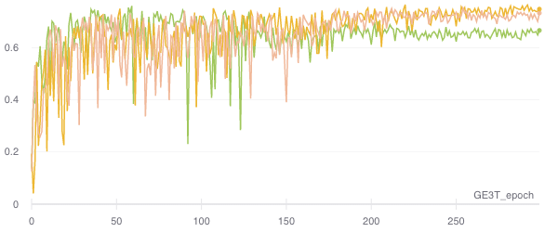
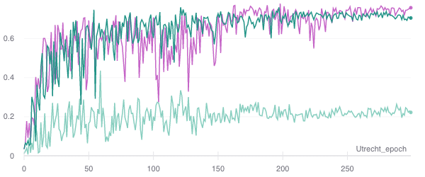
Promising Preliminary Results
Segmentation Accuracy Over Training Iterations
Source: A, B
Target: C
3 Scanners (domains): A, B, C
Train on 2 sources
Test on 1 target
Higher results are from Xingchen’s models
Source : B, C
Target: A
Source: A, C
Target: B

Slide 17
Undergraduate Researchers Make Difference
Immense contribution by undergraduate researchers
Currently 2 BS and 1 BS/MS students doing independent research/capstone projects
Useful to have some background in CV/ML/DL (intro courses) and coding skills (PyTorch or other DL frameworks) but not absolutely necessary
Prior knowledge in medical imaging is not required
sjh95@pitt.edu 5427 Sennott http://pitt.edu/~sjh95/

