Slide 1





CAPRIO: Context Aware Path Recommendation exploiting
Indoor and Outdoor information
C. Costa, X. Ge, B. Nixon, P. K. Chrysanthis
Advanced Data Management Technologies
School of Computing and Information
Dep. of Computer Science, University of Pittsburgh, USA
https://admtlab.com/caprio/
CS Undergraduate Research Symposium
School of Computing and Information, Department of Computer Science

Slide 2
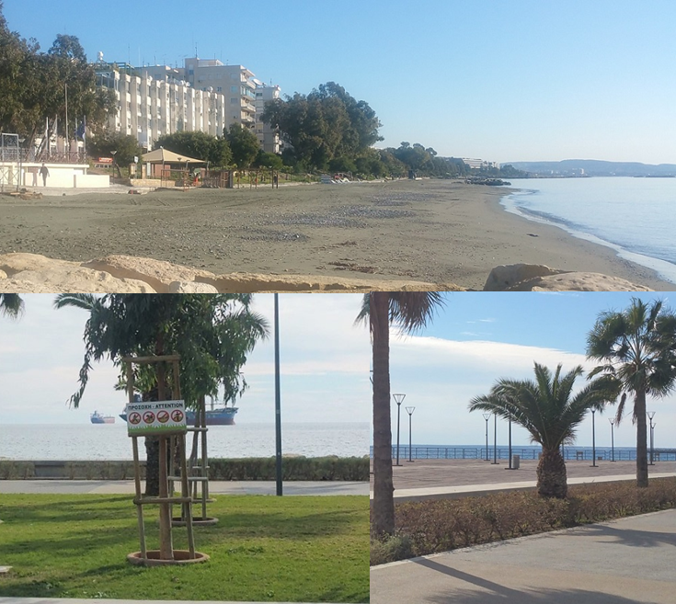
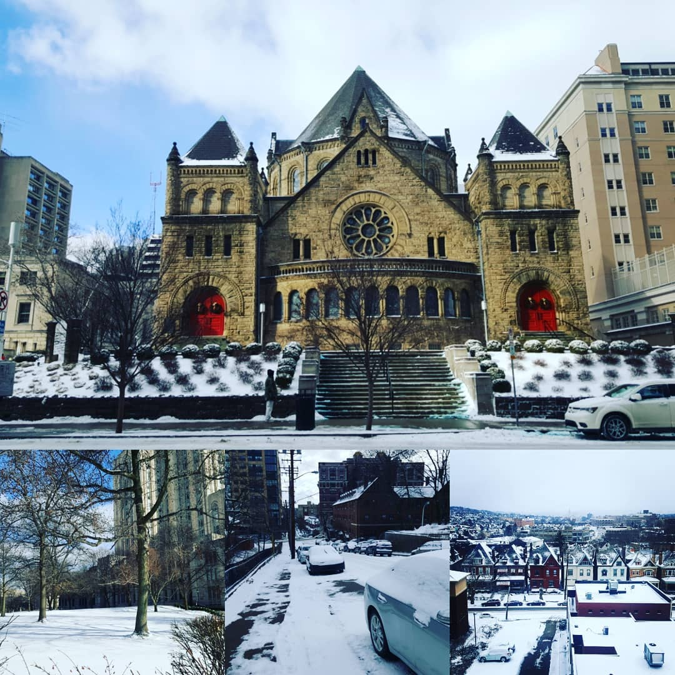


CAPRIO - How everything started
Started as a “simple” idea
I came to Pittsburgh from Cyprus on January 2019
Weather in Cyprus
(in January)
Weather in Pittsburgh
(in January)
A regular day in Pitt: …
Costas: I am very cold ☹
Panos: Hm … Let’s do something about it … We are computer scientists ☺
Let’s create a system!!!

Slide 3
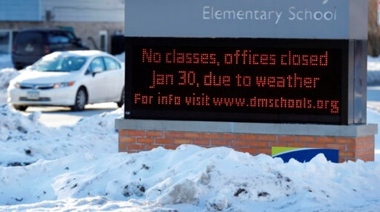




Motivation
Enabling navigation that considers the indoor or outdoor context:
  Minimizes the outdoor or indoor section of a path that has vital role during extreme weather conditions, natural disasters and pandemics.
  Recommends paths that satisfy the accessibility constraints
CNN: polar vortex
in Iowa, 2019
BBC: heatwave
in Japan, 2018
CNN: Congestion at Liverpool Street station in UK, 2019
COVID-19 with Over 2 million cases in US, 2020
32 million of adults in US have some type of mobility disability

Slide 4








CAPRIO v2.0 Approach
Navigation solutions primarily focus on outdoor or indoor localization and navigation.
Only a handful of the state-of-the-art solutions consider outdoor-indoor seamless transition (switch) techniques.
CAPRIO v2.0 Approach: Supports a multi-objective context-aware path recommendation that exploits Indoor and Outdoor information (e.g., accessibility, indoor congestion, outdoor exposure, distance).

Slide 5
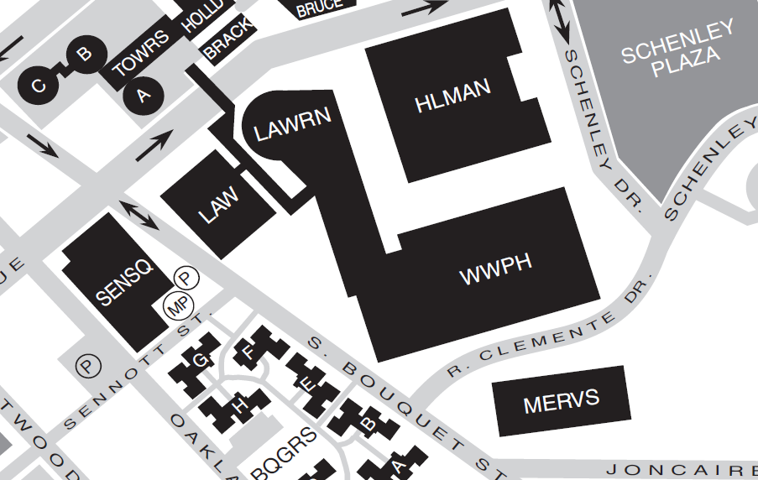
CARPIO v2.0 Solution

Slide 6
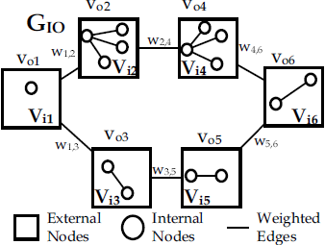
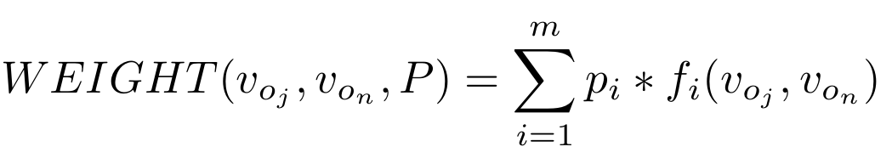
GIPDv2 Overview
Step 1: Graph creation and initialization
  The graph is initialized with all the outdoor vertices V_{o}
  Indoor accessibility graph
Step 2: Graph integration and Weight derivation
  The weight w of each edge is calculated based on user’s preferences P
Step 3: Shortest path discovery - Linear scalarization
  Any algorithm can be applied (e.g., Dijkstra, Floyd-Warshall, Bellman-Ford)

Slide 7
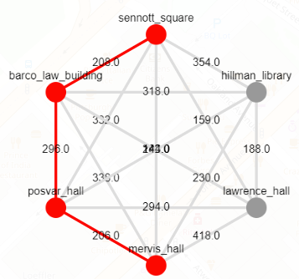
CAPRIO v2.0: Overview
CAPRIO v2.0 has 3 layers:
  Data Layer
    ETL the data to be process
  Processing Layer
    Integrate the indoor and outdoor info
    congestion forecasting
      LSTMs given time and SMI
    accessibility
  Application Layer
    User interface & Open API
Notes:
CAPRIO v2.0 offers enhanced indoor context-awareness in terms of accessibility and congestion

Slide 8
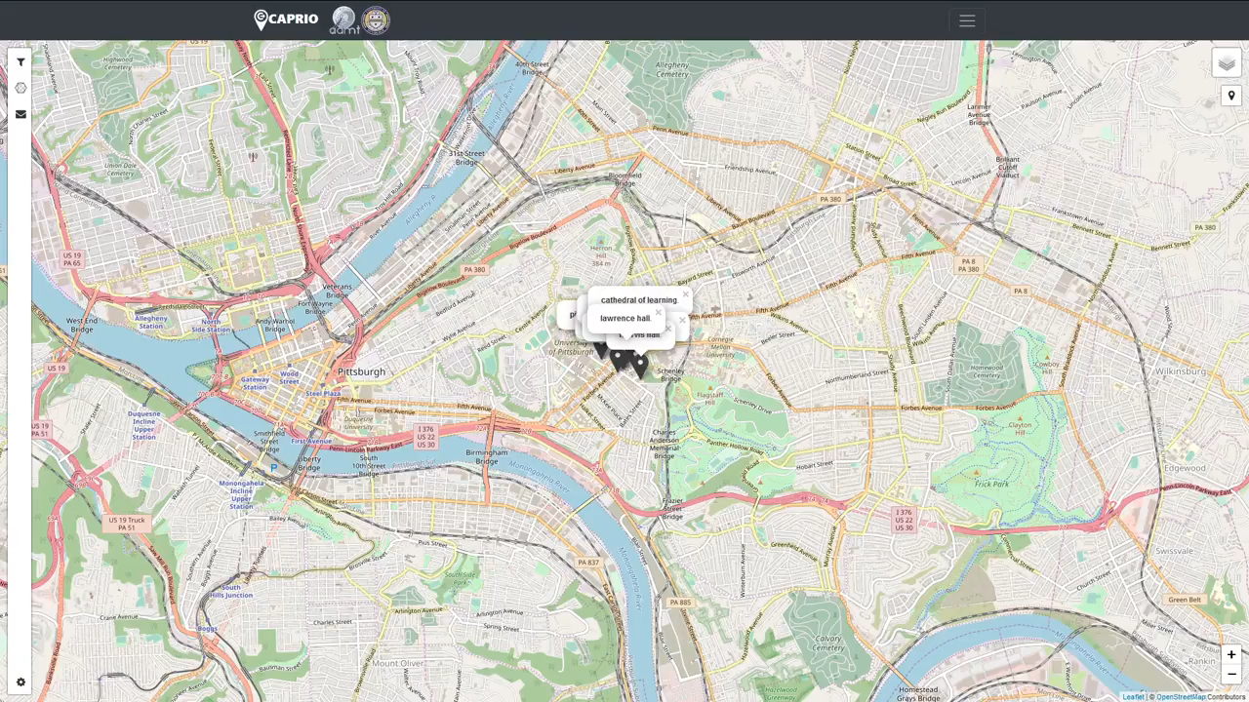
Demo

Slide 9
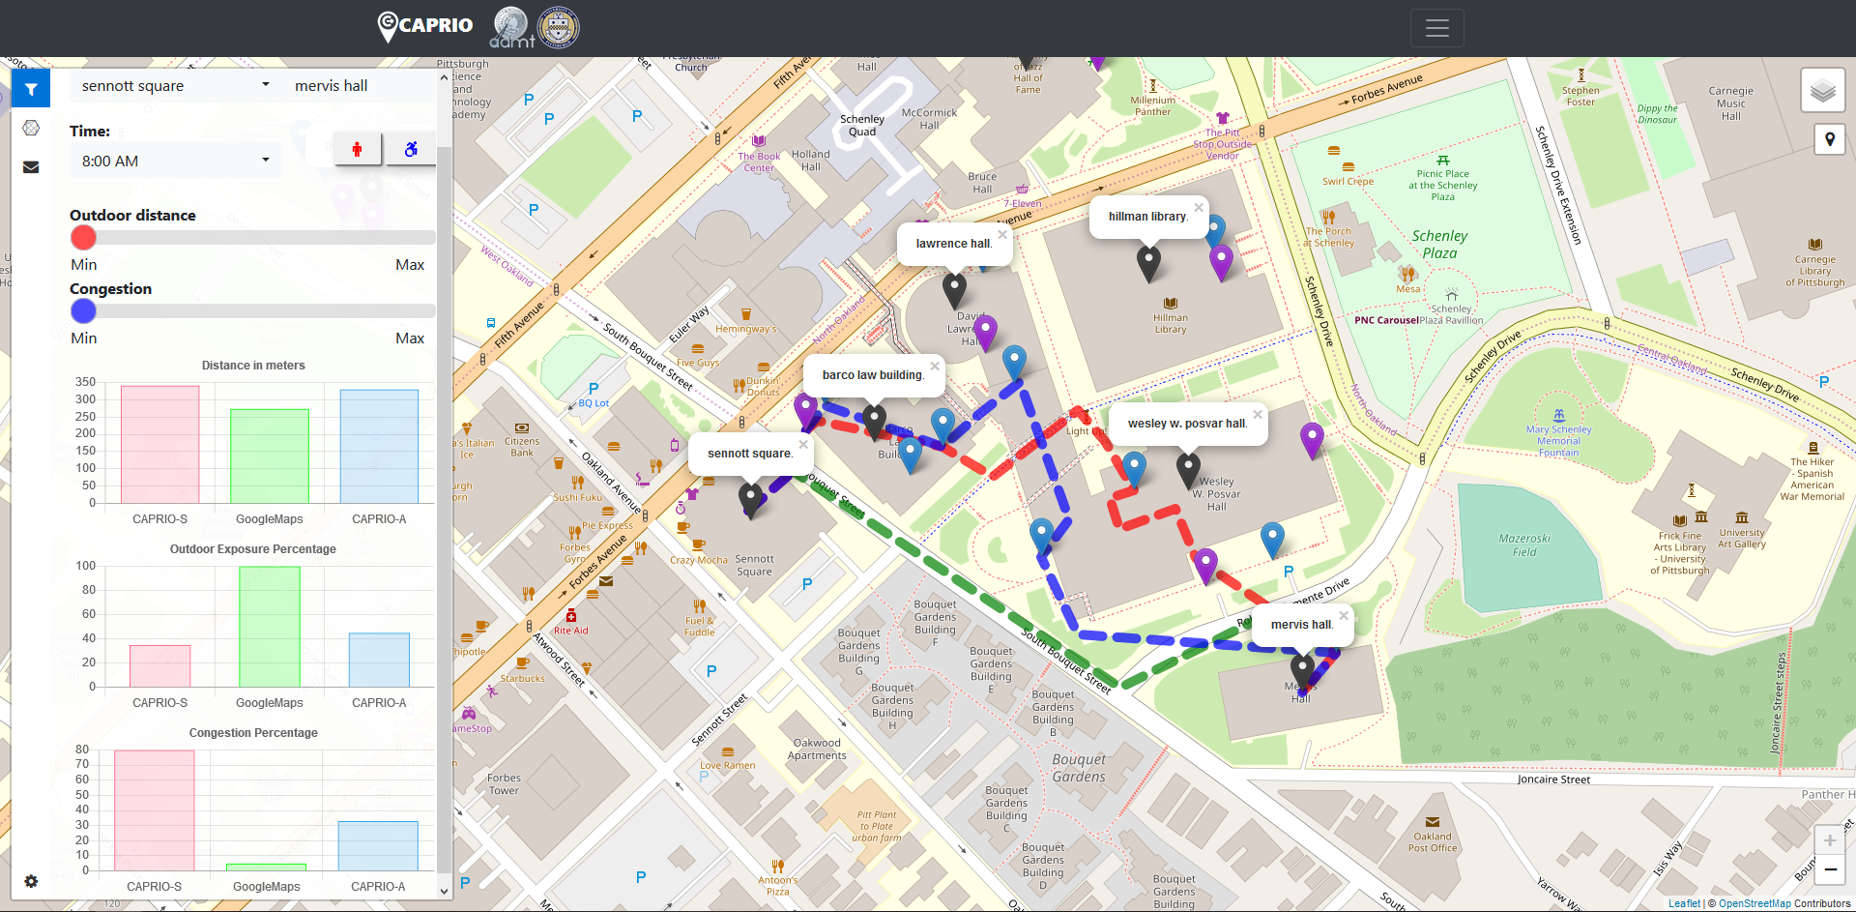
CAPRIO v2.0

Slide 10
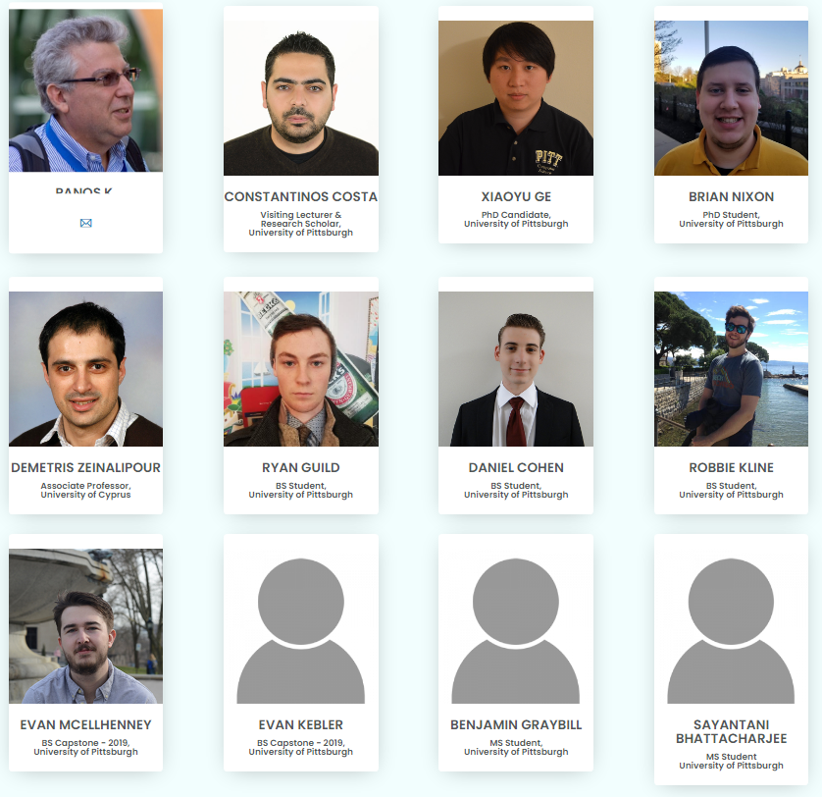
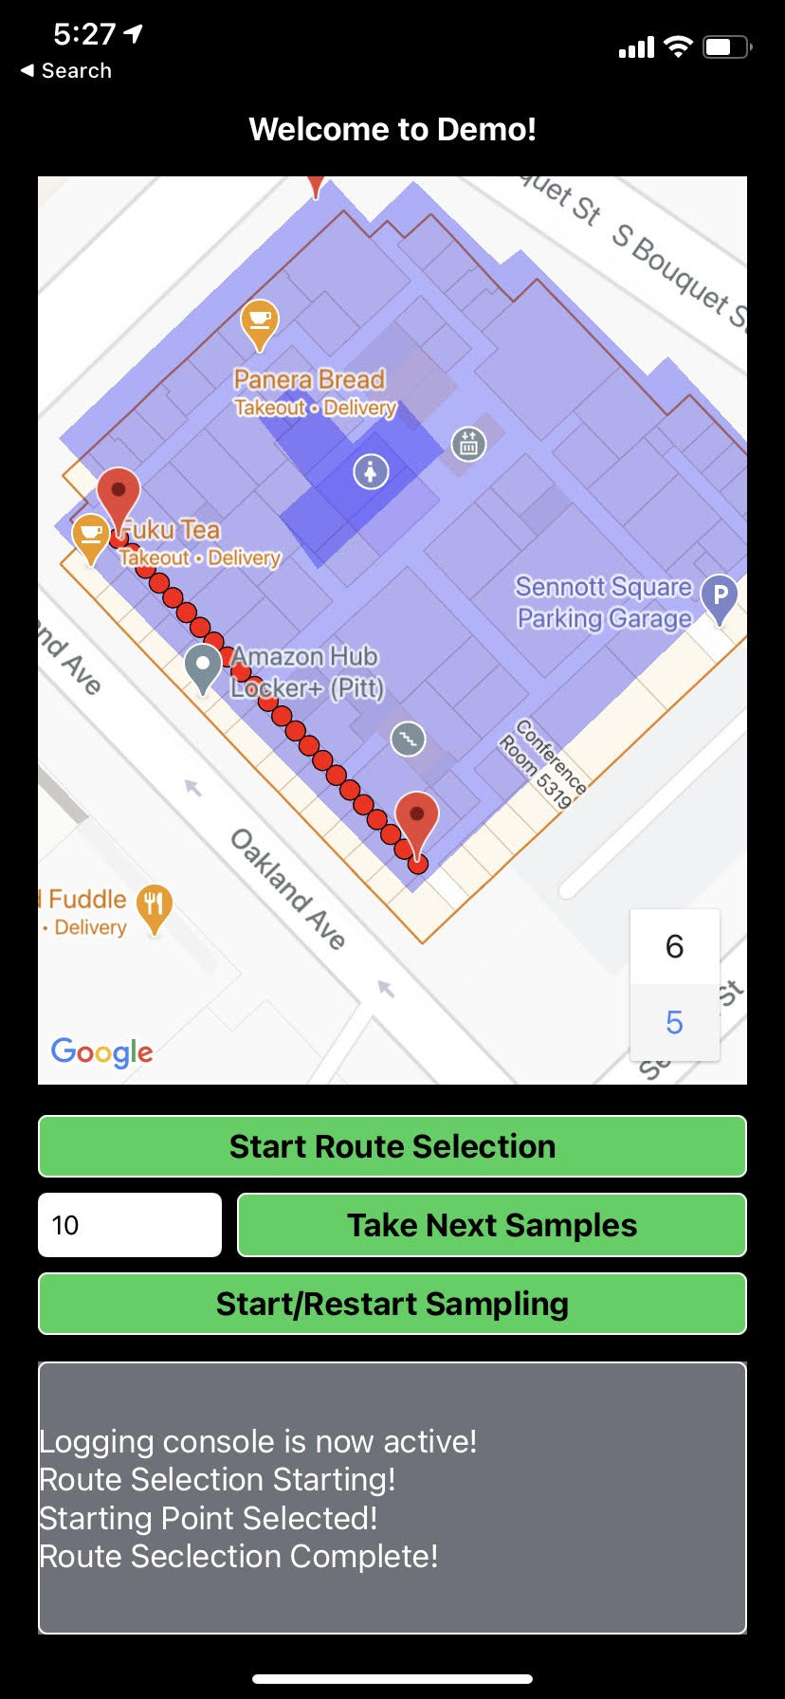

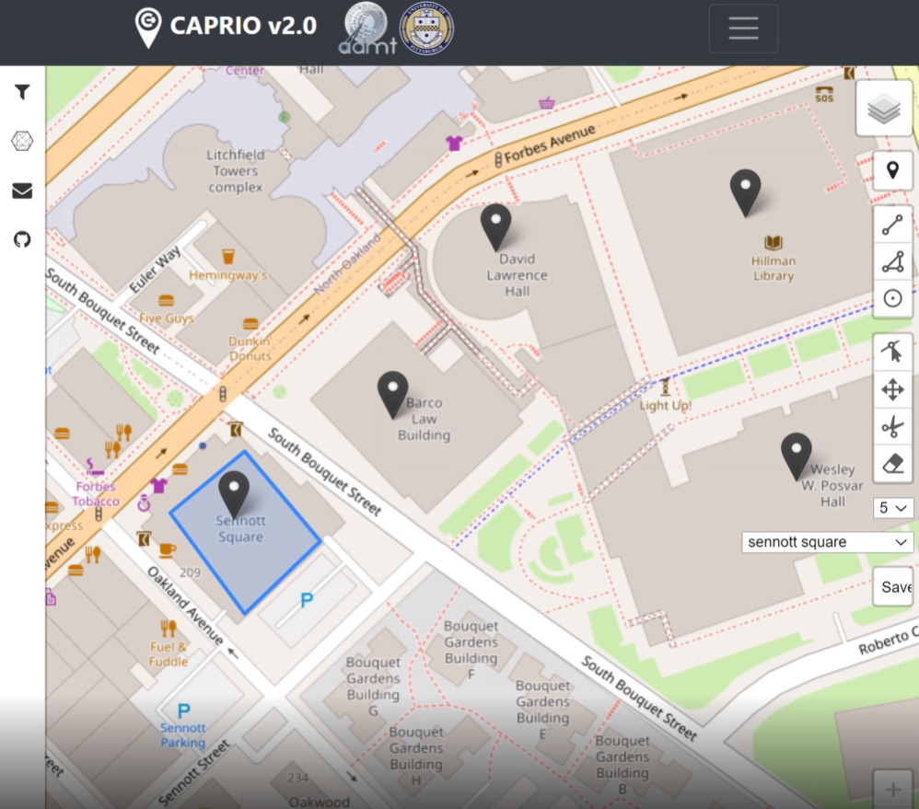
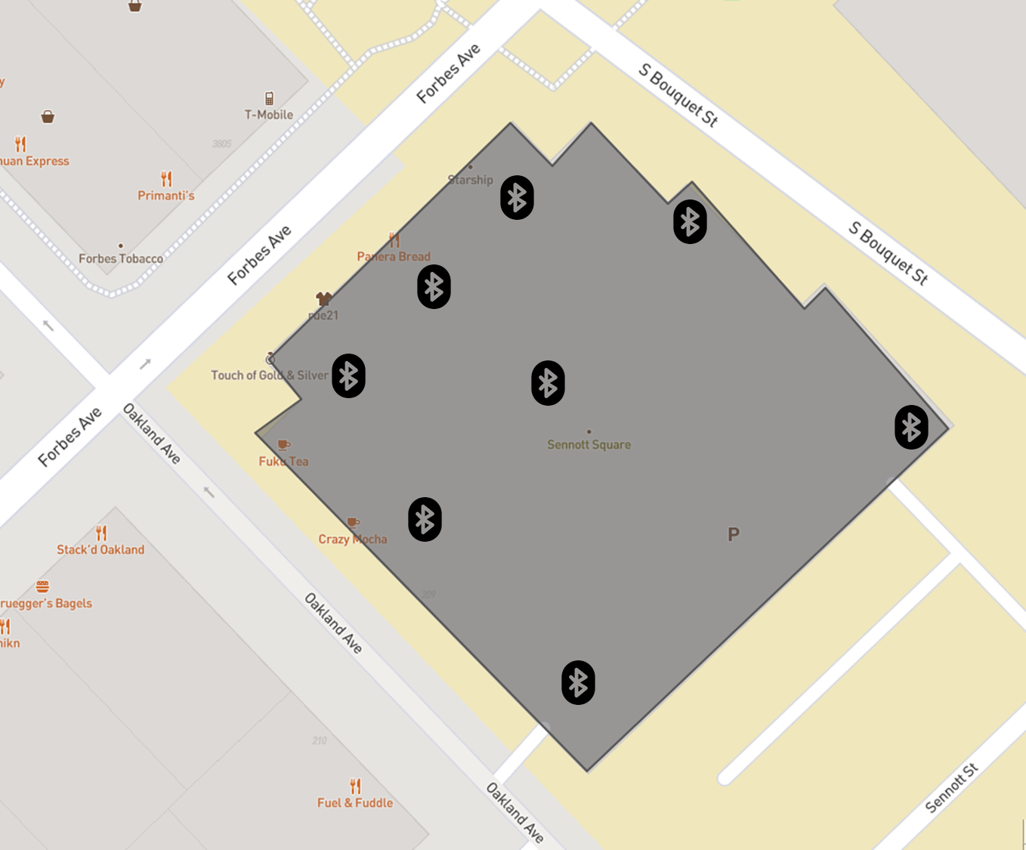
CAPRIO Team

Slide 11
CAPRIO: Context Aware Path Recommendation exploiting
Indoor and Outdoor information
Thank you!
C. Costa, X. Ge, B. Nixon, P. K. Chrysanthis
Advanced Data Management Technologies
School of Computing and Information
Dep. of Computer Science, University of Pittsburgh, USA
https://admtlab.com/caprio/
CS Undergraduate Research Symposium
School of Computing and Information, Department of Computer Science

